Slide 1

Long Term Condition Locally Enhanced Service
19th February 2025

Slide 2
Contents of Session
Introduction
Part I – Aims, Objectives and Structure
Part II – How to Deliver the LTC LES
Part III – Monitoring Requirements
Part IV – Questions & Further Supporting Documentation

Slide 3
Part I
Aims, Objectives and Structure

Slide 4
Intentions:
Balance
Needs of the individual patient
Reducing urgent care system pressures
Developing an inclusion health approach
Effective resourcing to ensure practice sustainability

Slide 5
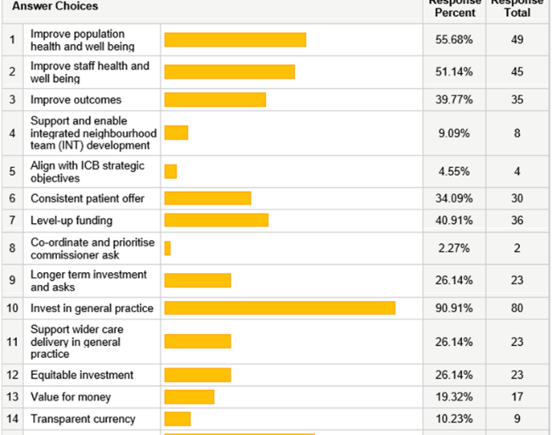
Learning from GPQC 24/25
Across each of the domains be able to focus on individuals most at risk within our populations and meet their needs.
Focus on top three items and promoting investment in General Practice.
Approach from holistic frailty assessments borrowed.

Slide 6
Clinical Areas of Focus
Clinical Case Finding
Population Health Management
Long Term Condition Selections
  Coronary Heart Disease
  Respiratory
  Diabetes
  Frailty (Moderate & Severe)
Severe Mental Illness

Slide 7
Delivery Structure
Resource % |  | Activity Expectation
35% | Domain 1 | Implementation Administration & support to care coordinator/navigation support Case finding and risk stratification work Monitoring of outcomes and reporting Training needs assessment and meeting training requirements to deliver this LES Building relationships across practices and partners and ‘headspace’ for leadership and transformation activity
53% | Domain 2 | Segment 1 | Segment 2 | Segment 3 | Segment 4 | Segment 5
 |  | Clinical Case Finding | Population health Management | Long Term Condition 1 | Long term condition 2 | Severe Mental Illness
 |  | Case finding chosen according to variance from expected population prevalence | Use risk stratification and Inclusion Health knowledge to identify cohort. | Place based decision based on pop health and Place based knowledge | Place based decision based on pop health and Place based knowledge | Universal focus on individuals with SMI, undergoing stratification of health inclusion risk
12% | Domain 3 | MDT approach Practice level MDT, PCN level or collective MDT based on historic multi-practice working. Details and guidance about formation and delivery of MDT laid out in this specification.

Slide 8
Activity and Resource Structure
PRACTICE EXAMPLE
Domains
Domain 1 - Implementation | 35% of total achievable payment
Domain 2 – Assessments | 53% of total achievable payment
 | Total activity target: | 100
 | Segment 1 - Clinical Case Finding (10% minimum of total activity) | 10
 | Segment 2 - Population health Management (10% minimum of total activity) | 10
 | Segment 3 - Long Term Condition 1 (10% minimum of total activity) | 10
 | Segment 4 - Long Term Condition 2 (10% minimum of total activity) | 10
 | Segment 5 - Severe Mental Illness (5% minimum of total activity) | 5
 | Total for all 5 segments | 45
 | Remaining assessments out of the total 1000 activity Target: These can be allocated across any of the five segments at the practice’s discretion. | 55
Domain 3 – MDT Approach | 12% of total achievable payment
Indicative numbers will be provided to each practice ahead of contract implementation.

Slide 9
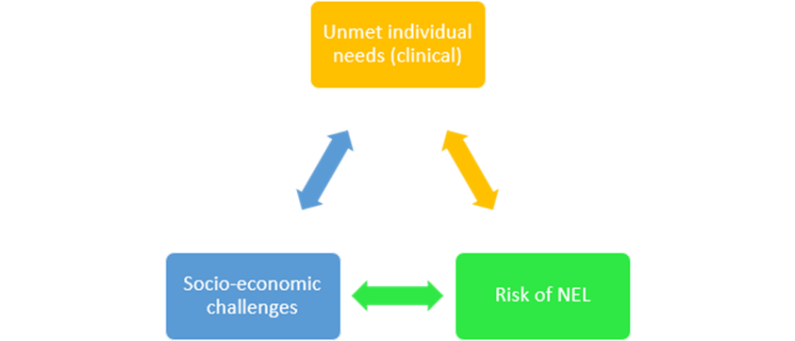
Choice of Long Term Conditions
Derogation of decision to Place level.
Data informed decision making
Using local knowledge and expertise to ensure that the choice of LTC meets the intentions of the LTC LES.
Groups meeting in next 1-2 weeks

Slide 10
Part II
How to Deliver the LTC LES

Slide 11
LES Delivery Outline
Domain 1 (35%): Implementation
  Supporting delivery and development needs
Domain 2 (53%): Holistic Health Assessments
  Delivering the assessments across all segments
Domain 3 (12%): Holistic MDT
  Developing a local holistic MDT

Slide 12
Domain 1(35%): Implementation
Support Delivery
Support Development
Cohort searching
Associated Administration
Planning and ‘headspace’ time
Specific training required
Practice leadership development
Support integration with local services
Practice development of inclusion health approach.
Resource provided to practices to undertake the above actions

Slide 13
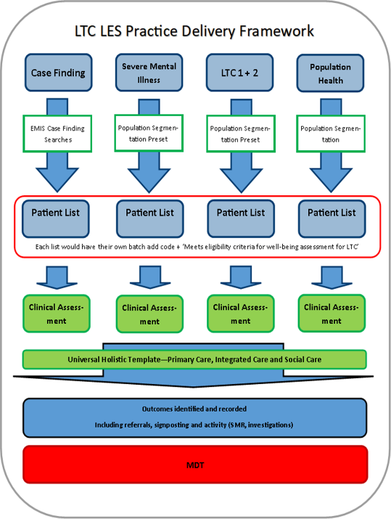
Domain 2 (53%): Holistic Health Assessments
Stages:
Cohort Identification
Cohort Labelling
Holistic Health Assessment
Actioning Outcomes
(MDT)

Slide 14
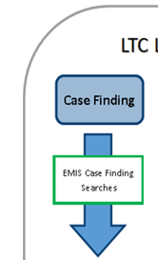
Stage 1: Cohort Identification: Clinical Case Finding
Built around EMIS search parameters
To identify individuals at risk of having an undiagnosed illness and/or inclusion health needs.
To meet unmet need and improve practice prevalence (if appropriate)
Searches provided by CSU DQ team.

Slide 15
Stage 1: Cohort Identification: CCF Search List
Hypertension
  Raised BP without diagnosis in past 3 years
  Filtered by either NEVER Covid vaccine or HIGH Townsend Score
CHD
  On antianginal drugs but not on CHD register
  Has CHD monitoring codes, not on CHD register
Respiratory
  Has Respiratory monitoring codes or medications, not on register
Heart Failure
  Raised BNP and no HF code
SMI
  On SMI medications (antipsychotics/lithium) and no SMI diagnosis

Slide 16
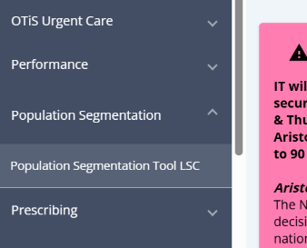
Stage 1: Cohort Identification: Aristotle
The remainder of the cohorts are available to download from the ‘Population Segmentation Tool LSC’ within Aristotle.
Able to use presets to identify each cohort quickly and filter by Acorn Specialist Wellbeing parameters to enable inclusion health goals
Then able to export cohort to EMIS Web to batch add relevant codes

Slide 17
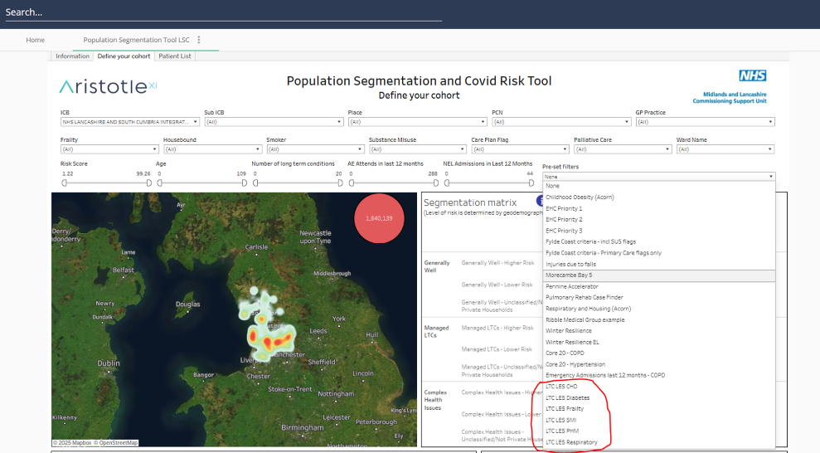
Stage 1: Cohort Identification: Aristotle

Slide 18
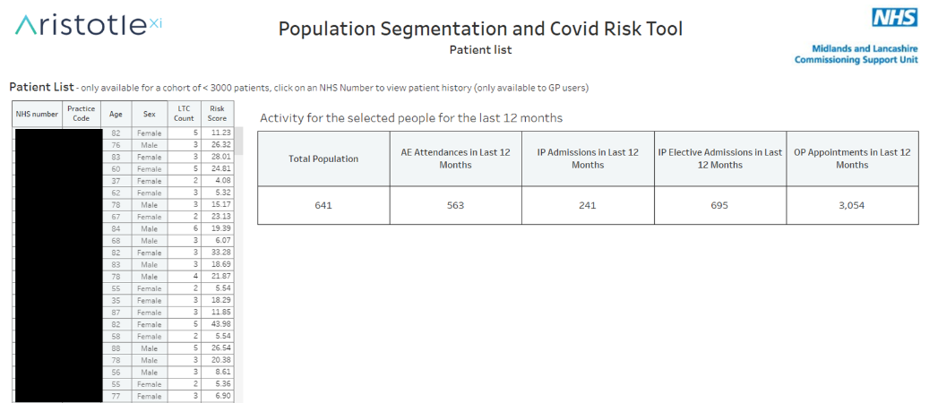
Stage 1: Cohort Identification: Aristotle

Slide 19
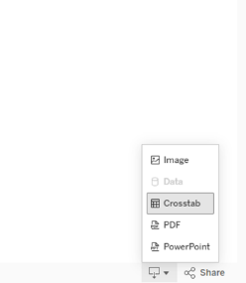

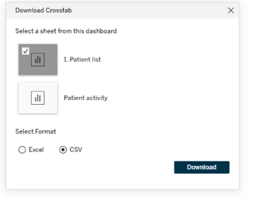
Stage 1: Cohort Identification: Aristotle
Should be as a .txt file with only NHS numbers in

Slide 20
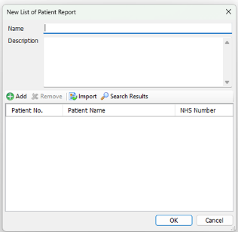
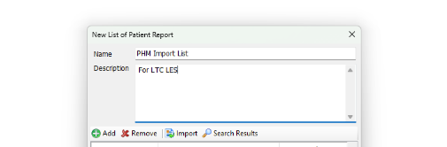

Stage 1: Cohort Import into EMIS Web
Population Reporting >> New list of patients report

Slide 21
Stage 1: Cohort Identification: Aristotle
Repeat for relevant Cohorts:
  Population Health Management
  Long Term Condition 1
  Long Term Condition 2
  Severe Mental Illness
Import all cohort lists separately into EMIS.

Slide 22
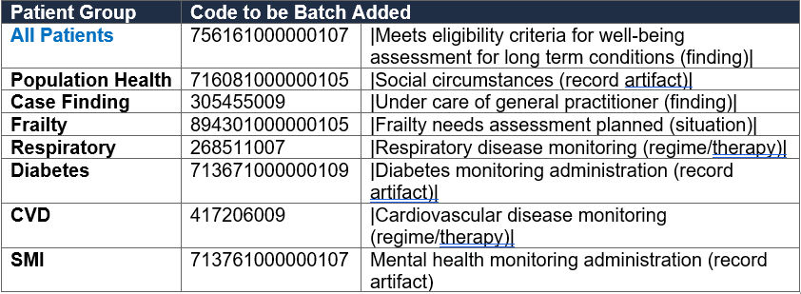
Stage 2: Cohort Labelling

Slide 23
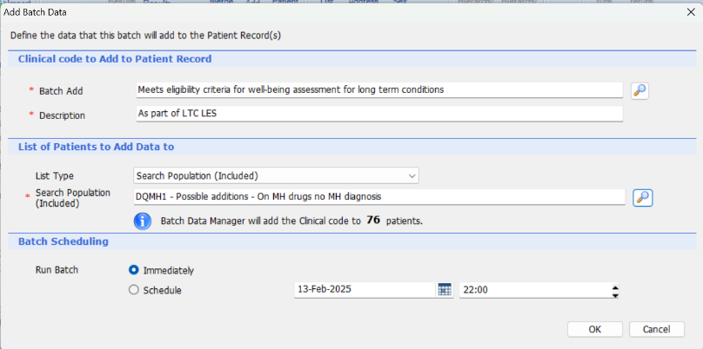
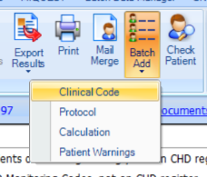
Stage 2: Cohort Labelling: CCF

Slide 24
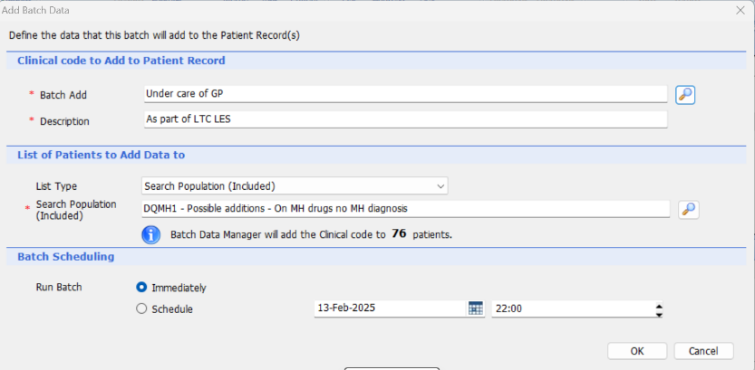

Stage 2: Cohort Labelling: CCF
Critical to add LTC code AND Under care of GP code on same day

Slide 25
Stage 3: Holistic Health Assessment (HHA)
The Holistic Health Assessment is to be undertaken for each patient regardless of which cohort is being worked through.
+
This should be accompanied by a separate appropriate clinical assessment (e.g. Diabetes or ?hypertension assessment)
Flexibility about how to deliver these two components and appropriate use of staff.
The HHA must be recorded on the provided template
The clinical assessment can use any appropriate format

Slide 26
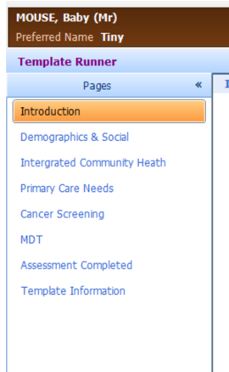
Stage 3: Holistic Health Assessment (HHA)
Parts of this should look familiar!
Enhanced Health Check
Frailty template
Pilot work from 2022

Slide 27
Stage 3: Holistic Health Assessment (HHA)
General Guidance:
Not every data item will be applicable or relevant for each patient.
Additional information is provided to support delivery and signposting.
Actions and outcomes must be captured where appropriate, not all actions will be able to be captured.
Some data items will be monitored for quality purposes (consent for record sharing, carer status and ethnicity for instance)
Ensure type of clinical assessment captured (if more than one please select most appropriate

Slide 28
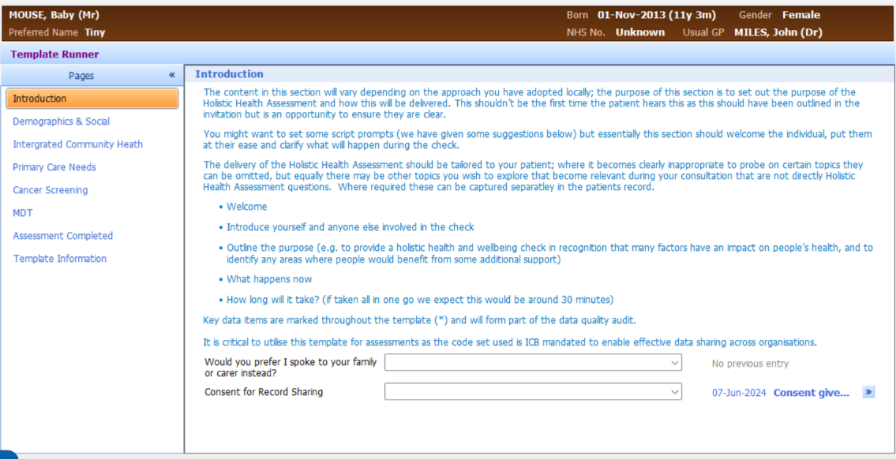
Template – page 1

Slide 29
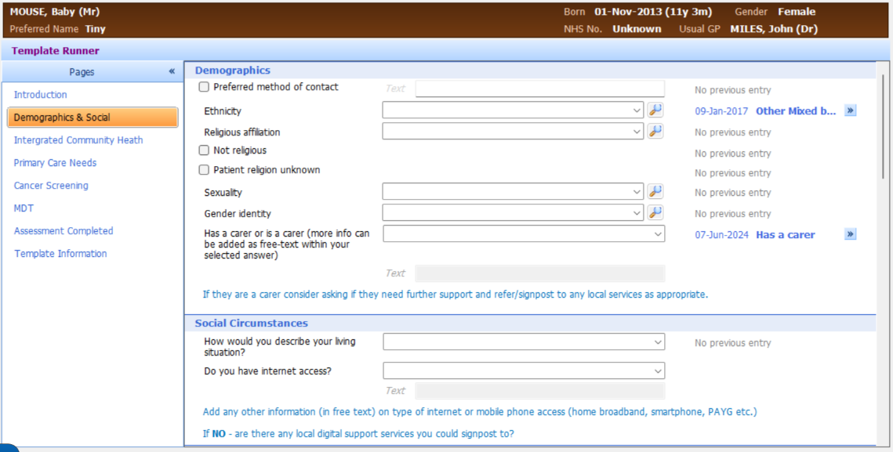
Template – page 2

Slide 30
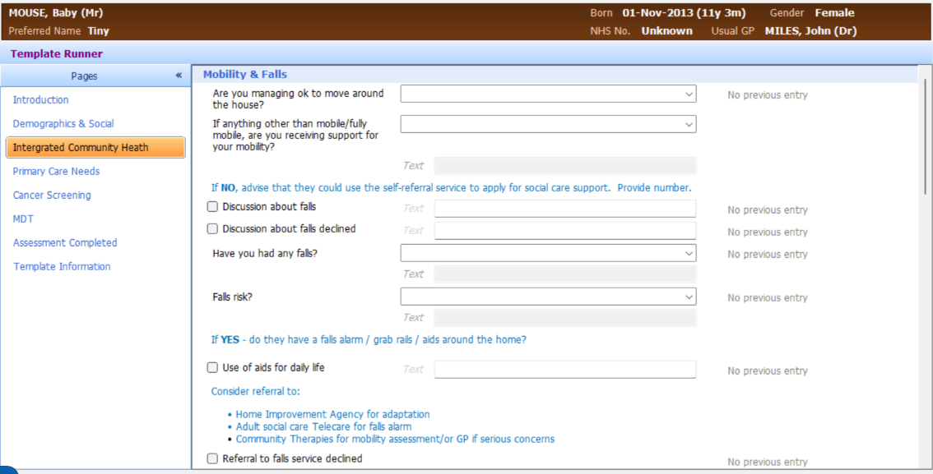
Template – page 3

Slide 31
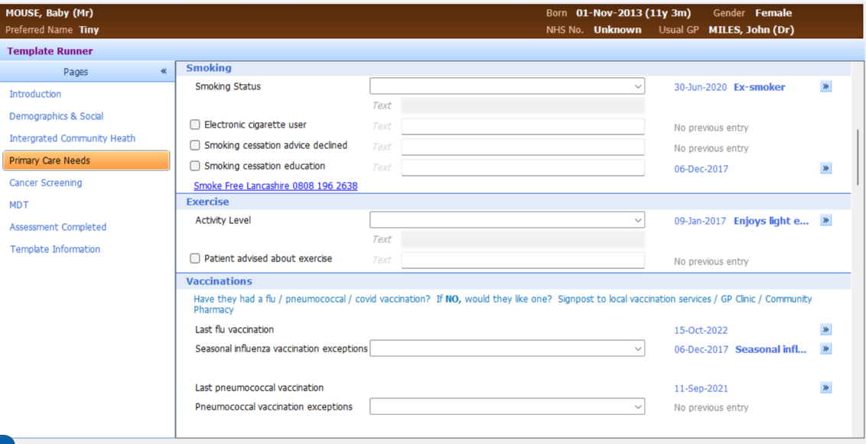
Template – page 4

Slide 32
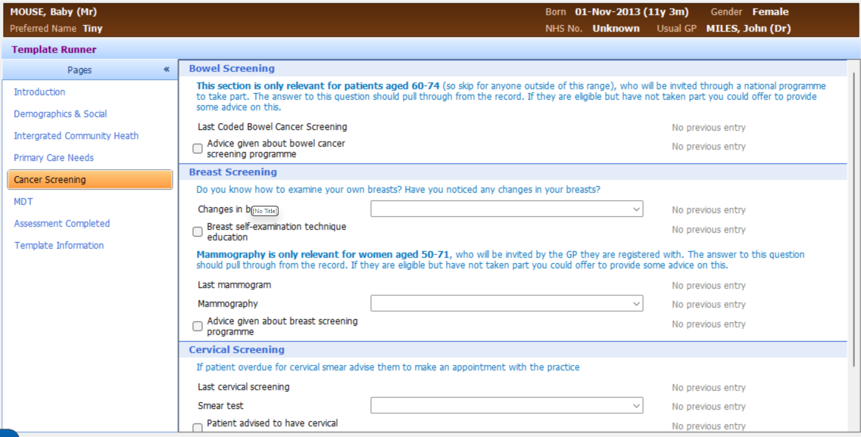
Template – page 5

Slide 33
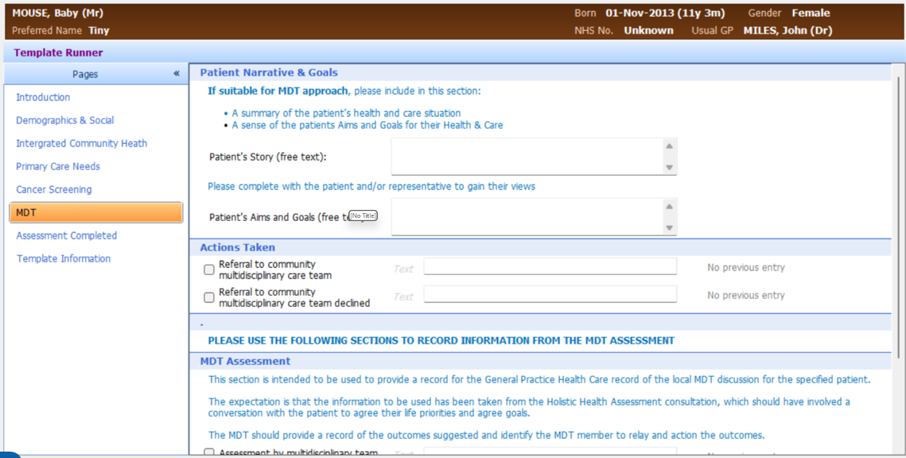
Template – page 6

Slide 34
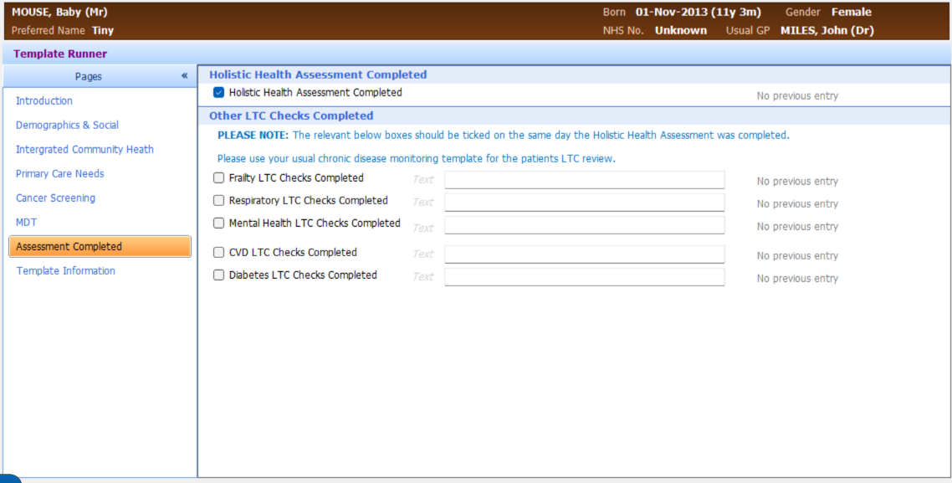
Template – page 7

Slide 35
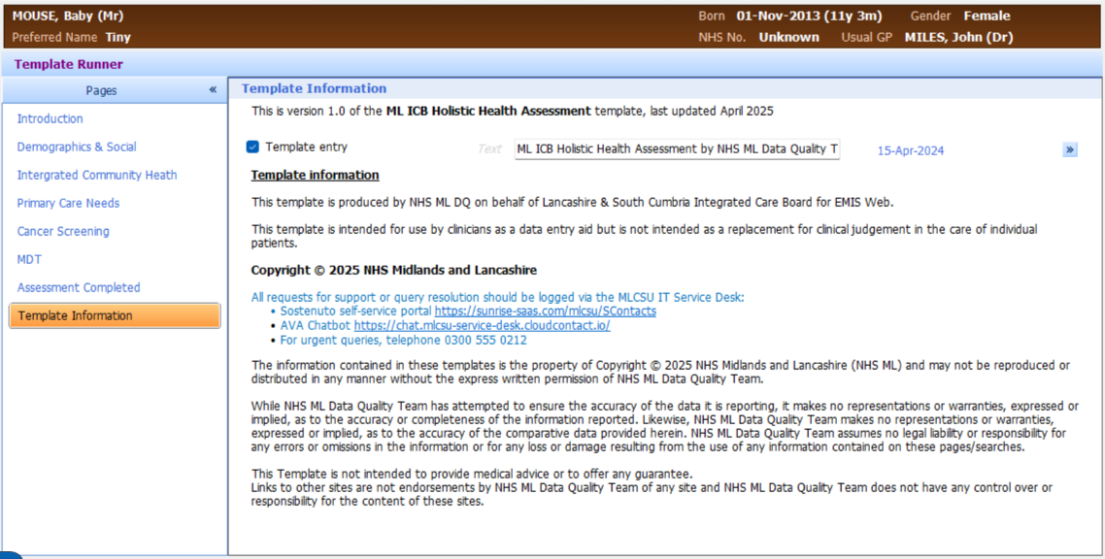
Template – page 8

Slide 36
Stage 4: Actioning Outcomes
Each page has a drop down box for outcomes.
Please complete as many as appropriate and refer or signpost as appropriate

Slide 37
Domain 3(12%): Holistic MDT
Activity is not monitored for 25/26
The expectation is:
  Set up a working core team Holistic MDT
  Actively review patients with multiple unmet needs and/or significant need identified that may benefit from holistic MDT input
  Record activity as outlined in the MDT part of the HHA template
NOT a specialist condition MDT but may be able to draw in specialist input if required

Slide 38
Domain 3(12%): Holistic MDT
Throughout the 12 months span of the 25/26 LTC LES there is the intention to establish the core MDT set up and look towards an extended or integrated MDT structure.
The leadership/integration/population (35%) development resource outlined within the LTC LES implementation document should be used to further evolve the MDT structure locally.
The intention is that the MDT and LTC LES be deliverable by individual practices, there is the opportunity, where appropriate, for practices to work together (e.g. PCN footprint) to deliver this portion of the LTC LES for reasons of scale and local service engagement.

Slide 39
Domain 3(12%): Holistic MDT
Core Holistic MDT
Extended MDT
General Practitioner
Advanced Clinical Practitioner
Care Co-ordinator
General Practitioner
Advanced Clinical Practitioner
Care Co-ordinator
Social Care
Nursing staff
Mental Health
Pharmacy
Admin

Slide 40
Domain 3(12%): Holistic MDT
The above is not intended to be prescriptive
Provide flexibility to meet the development needs of each practice
Functions are more important than job titles
Looking to develop structures for the future

Slide 41
Part III
Monitoring Requirements

Slide 42
Domain 1 (35%): Implementation
Completion Date 30th May 2025
Indicative outline (non-binding) of intentions for resource utilisation
Part I Delivery plans
Part II Development plans
Single page formative – no data/costings required

Slide 43
Domain 2(53%): Holistic Health Assessments
Coded data extracted from practice on a monthly basis.
To assess
  Cohort numbers
  Assessments undertaken
  Quality Markers
Single cohort import at start of year to enable practices to plan workload.
Targets and resource allocation released to practices.

Slide 44
Domain 3(12%): Holistic MDT
Completion Date 1st October 2025 and 31st March 2026
Two submissions detailing MDT progression (forms supplied):
MDT Activity data collated on monthly basis (formative) to enable planning for 26/27
MDT Participants (list): | e.g. GP, Practice Nurse or ANP etc.
Development narrative | e.g. How the group was formed (brief)
Development benefits | e.g. beneficial impact to patients/practice
Development challenges | e.g. finding difficult to expand because etc.

Slide 45
Payment Schedule
Practices receive 80% of payments upfront, distributed evenly over 12 months, with the remaining 20% of payments paid at year end following a reconciliation of final achievement figures against your quality contract targets.
Below is a reminder of how the reconciliation will work:
Underachievement (<80%): If your practice does not achieve 80% of the targets by the end of the year, any overpayment made during the upfront instalments will be recouped in the June 2026 payment run.
Achievement (80%–100%): Practices achieving between 80% and 100% of their targets will receive the calculated balance of their payment (up to the 20% remaining) in the June 2026 payment run.
Overachievement (>100%): Practices delivering activity beyond the capped 100% targets will not receive additional payments for exceeding these targets.

Slide 46
Part IV
Questions & Further Supporting Documentation

Slide 47
Key Document List
LTC LES Service Specification
Technical Guidance covering DQ and BI support*
Domain 1: Implementation submission form*
Domain 3: Holistic MDT submission form*
*In development

Slide 48
Questions?

