Slide 1



Lancashire and South Cumbria
Transforming Community Care Milestone Planning

Slide 2
TCC Vision
To achieve our vision of having a high quality, community-centred health and care system by 2035, the ICB is undertaking an extensive programme of work to transform community care.
The ambition is to keep people safe and well at home, by bringing care closer to where they live and treating more people outside of a hospital setting where possible.
Over the coming months, we will produce a 2–10-year transforming community care strategy which is led by clinicians and co-produced with people living in Lancashire and South Cumbria.

Slide 3
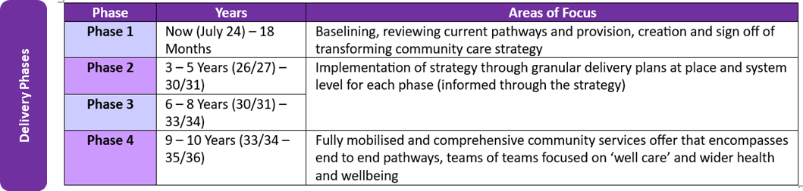
Milestones
Where we are now

Slide 4
Milestones Phase 1 High level June 2024 – 18 months
The original Phase 1 plan launched July 2024 and was set to run for 24 months. The Senior Programme managers are now in post and will bring forward the completion of phase 1 by 6 months, therefore to complete phase 1 by end July 2025, and launch phase 2 August 2025.
Activity | Integrated Neighbourhood Teams | Enhanced Care in the Community | Creating Healthier Communities | Transforming Community Care | Risks
Baselining | End of January 2025 Heatmap/priority areas identified | End of February 2025 | End of April 2025 | End of April 2025 | Current community services outcomes, cost and gaps – Kingsgate
Reviewing Pathway provision | End of February 2025 | End of March 2025 | End of May 2025 | End of May 2025
Development of the TCC strategy | Visioning Session 10th February 2025, Draft mid February, End of March 2025 sign off |  |  |  | Approval pathways need to be understood
Operational Metrics | End of February 2025 | End of March 2025 | End of April 2025 | End of April 2025 | Dependent on the Business Intelligence Team
Gap Analysis Matrix | End pf April 2025 | End of May 2025 | End of July 2025 | End of July | Kingsgate
Technology Enablement – Shared Care record | January – March 2025 – Draft scope each areas for 2025/26 January – March 2025 – Baselining exercise, what do we have now, WGLL February – March 2025 – Planning requirement, commissioning intentions, collaborative work programmes |  |  |  | Large scale communication & engagement plan at pace needed
Communication, Marketing & Engagement Strategy | 20th January detailed action plan for Q1 and Q2 2025/26 Finalise February 2025 Deployment April 2025 |  |  |  | Little to no communication currently in circulation

Slide 5
Milestones Phase 2 High level for development
The original Phase 2 plan 3-5 years 3-5 years (2026/27 to 20230/31) included the implementation of the strategy and delivery plans
Activity | Integrated Neighbourhood Teams | Enhanced Care in the Community | Creating Healthier Communities | Transforming Community Care | Risks
Implementation Strategy
Granular Level Detail plans at Place
Granular Level Detail plans at System Level
Test Areas identified
Technology Enablement – Shared Care record
Communication, Marketing & Engagement Strategy
Measurement System inc. population health

Slide 6

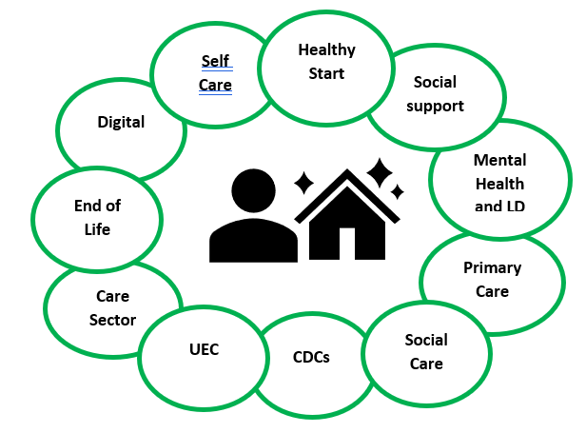
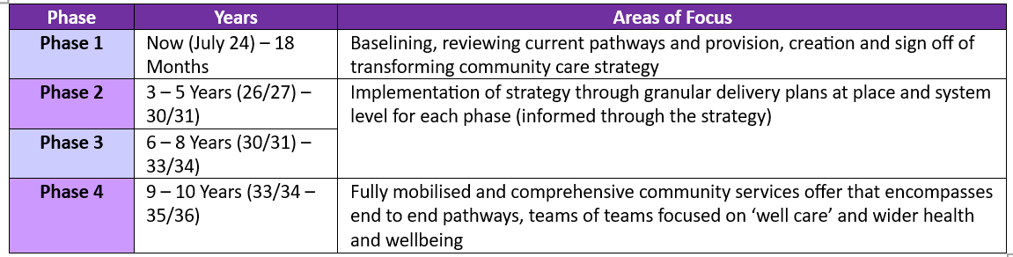

Programme Core Objective
Transforming Community Care – Plan on a Page
Focus on the medium to longer term clinically led transformation of community services that is co-produced with LSC residents – with a 2–10-year strategy and delivery roadmap leading up to the new hospitals being in operation in 2035
Programme Leadership
Strategy
National Health and Care Triple Aims
Better Care for All
Better Health and Wellbeing for Everyone
Sustainable Use of NHS Resources
Executive SRO – Sarah O’Brien
Statutory Duty to Reduce Health Inequalities
Delivery of the NHS Long Term Plan 2019 - 2029
Improve Quality, Safety, Clinical Outcomes and Patient Experience
Equalise Opportunities and Clinical Outcomes Across the Area
Meet National and Locally Determined Performance Standards and Targets
Joint Strategic Needs Assessment
Portfolio Director - Tony McDonald
ICB Core Objectives
Core20Plus5
Make working in LSC an Attractive and Desirable Option for Existing and Potential Employees
Meet Financial Targets and Deliver Improved Productivity
To Develop and Implement Ambitious Deliverable Strategies
National Healthcare Inequalities Improvement Programme
Public Health Atlas of Variation
Workstreams
Enhanced Care in the Community
End to end pathways - Supporting people to recover and increase independence through time limited enhanced support based on the person’s needs to enable them to remain at home or as close to home as possible, utilising technology enabled care. Brings together care teams to deliver recovery, rehab, reablement, crisis services, end of life care, mental health and learning disabilities home-based and bed-based support
Anchor streams of work that connect / rely on delivery elsewhere in the system
EOL (ICB)
Vital and Vulnerable Services (ICB)
Care Sector (LA)
Virtual Care (ICB)
Creating Healthy Communities
Holistic approach to health and wellbeing - Connecting residents to each other and services available from local partners and local groups, activities and events through technology and other means. Providing a forum for ideas to emerge from the community. Encouraging residents to take control of their health & wellbeing through self care, prevention, healthy lifestyle choices and behaviours – adopting learning from the Healthier Fleetwood model and Whyndyke Farm ‘Healthy New Town’
Integrated Neighbourhood Teams
End to end pathways - Bringing together teams and professionals to improve care for neighbourhood populations. Primary, community, secondary and social care, mental health and learning disabilities, end of life, domiciliary and care staff and VCSE partners. A team of teams, utilising technology to deliver virtual care, sharing information and resources to improve health and wellbeing and tackle health inequalities through streamlined pathways and navigation
Delivery Phases
Interdependencies
UEC
Acute Configuration
We will manage interdependencies through matrix working across portfolios and ICB directorates to embed mechanisms and enable interdependencies to be proactively and relentlessly managed to drive delivery of the collective transformation agenda
NHP
Diagnostics
Primary Care
PHM
MH and LD
Regulated Care
Delivered through matrix working across functions, sectors, portfolios with residents at the centre

Slide 7
Programme Governance
Oversight & Advisory Group
Transforming Community Care Board
PCB Board
VCFSE Reference Group
Clinical Reference Group
Creating Healthy Communities
Integrated Neighbourhoods
Enhanced Community Care
Palliative End of Life Care
Virtual Care
Virtual & Vulnerable Community Services
Care Sector
Place Delivered
System and/or Place Delivered
Local Authority
Digital/Technology Enablement/Bi-Operational Metrics
Estates
Communication, Engagement & Marketing
Workforce
Notes:
Mental Health?
Reporting Line

Slide 8
Leadership
ICB (Commissioner)
Place (Delivery)
Provider (Services)
Provider: Each provider will lead elements and will embed a relentless but realistic focus on delivery at pace to maximise achieving benefits year on year
ICB: System leadership SRO Sarah O’Brien, Portfolio Director Tony McDonald, Clinical Leadership Stephen Sandford Chief AHP
The programme leadership for TCC, is delivered through matrix working by Senior Programme Leads: Sarah McCrossan, Brooke Banbury & Sinead Foster
Place: Place Integration Leads across all 4 places (Blackpool, BwD, Lancashire and South Cumbria) are supported by the ICB to deliver local plans and initiatives and longer-term transformation programmes. Clinical and Care professional leads and place operational teams
Notes:
Mental Health?
Reporting Line

Slide 9
Lancashire and South Cumbria
Integrated Neighbourhoods Milestone Planning
Sarah McCrossan

Slide 10


Each INT works through the four phases with support from system, place and borough-based partnerships, recognising that progress between the phases is not linear
Phase 1: Foundations and integrated practice
Phase 2: Population Health Management (PHM) with supporting infrastructure
Phase 3: Integrated and intelligence led practice
Phase 4: Full delegation for neighbourhood delivery of the LSC core 5 principles
INTs are defined around a geography, generalist team aligned, and leadership established
PHM est. and embedded: deep understanding of community through data and community connections driving preventative approach
Joint workforce planning and workflow allocation in the neighbourhood established
Shared Governance (clinical and financial) established
Processes for integrated practice are established and enacted across PC, Community, MH and VCS services
Interoperable IT systems are in place enabling joint care planning (shared care record) and risk management
Co-located, integrated services in place with consultant in-reach model confirmed
Full delegation of neighbourhood resources into a shared budget enabling integrated funding streams that deliver the LSC core principles
The population is understood with a sense of working in a team serving that population
Estate plan for the INT agreed, with a focus on single hubs established where possible and true integration of teams within
Integrated care pathways in place and models of delivery designed to meet the needs of the neighbourhoods
Accountability for delivery established to the ICB Executive
Functioning INTs in Place
PHM fully established, full digital health interoperability and estate solutions confirmed
INT jointly plans its workforce to deliver integrated care models
INT delivering demonstratable system benefits and outcomes

Slide 11
The minimum timescales for completing phases are set out on the roadmap (TBC) with the high impact outputs and anticipated benefits. We acknowledge some PLACES have a mature model where some are currently in the early stages of development
Phase 1: Foundations and integrated practice
Phase 2: Population Health Management (PHM) with supporting infrastructure
Phase 3: Integrated and intelligence led practice
Phase 4: Full delegation for neighbourhood delivery of the LSC core 5 principles
Functioning INTs in Place
PHM fully established, full digital health interoperability and estate solutions confirmed
INT jointly plans its workforce to deliver integrated care models
INT delivering demonstratable system benefits and outcomes
Targeting achievement by October 2025
Targeting achievement by March 2026
Targeting achievement by March 2027
Targeting achievement by March 2029
Indicators of achievement:
Processes are in place for measuring and reporting on improvements patient/citizen care through a more coordinated approach Shared Care Record (CLG or Delivery Units?)
Processes are in place to measure improvements in staff wellbeing and Case Management numbers
Outcomes:
Improvements in recorded prevalence ATTACHED TO THE LES/DES measures
Improvement in
Reduction in emergency admissions for >65s
Reduction in LoS >65s
De-Escalation of A&E pathways
Outcomes:
Reduction in A&E Attendances for High Intensity Users
Reduction in emergency admissions to hospital for Ambulatory Care conditions
Reduction in admissions to permanent residential are care home beds
Reduction in spot purchasing of CHC
Outcomes:
Improvement in key public health measures
Stable housing and employment for people with SMI alongside the proactive provision of health checks
Improvement against citizen and staff experience measures

Slide 12
Neighbourhood Overview – For Development
Lancashire & South Cumbria
Lancashire Place (19 INTS)
Blackburn with Darwen Place (4 INTS)
South Cumbria (9 INTS/ICCS)
Blackpool (11 INTS)
Greater Preston
Burnley West
Pendle West
Blackburn East
Blackburn West
Blackburn North
Barrow & Millom
Bay PCN
Grange & Lakes
Blackpool South
Fleetwood
Blackpool North
Hyndburn Central
Hyndburn Rural
Pendle East
Darwen
Kendal
Lancaster
Carnforth & Milnthorpe
Blackpool Central
Blackpool Central West
Blackpool South Central
Ribblesdale
Rossendale East
Rossendale West
Northern Parishes
Mid Furness
Western Dales
Blackpool North
Torebtum
Lytham St Annes & Ansdell
Burnley East
Preston North & East
Skelmersdale
Wyre Integrated Network
Wyre Rural Extended
Chorley Central
Chorley Together
Leyland
Ormskirk
Bridgedale & South Ribble
Chorley & South Ribble
Preston & South Ribble

Slide 13
A Team of Teams
What makes up the L&SC INT:
General Practice
Community Pharmacy
Community Dental
Community Eye Care
Community Services
  Children & Adults
  Physical and Mental Health Services
Community Consultants/Specialists
Secondary Care Consultant In reach
Social Care
Social Prescribers
Community Wellbeing Practitioners
Priority care models/pathways for delivery e.g. enhanced health in care homes linked to LES & DES
ADD INFOGRAPIC

Slide 14
For discussion at CLG
Reaffirm commitment to the direction to deliver a single vision?
Agree INT framework and mandate to proceed? ICB Architecture
How can we empower organisational leaders to accelerate integrated delivery at Neighbourhood level?
Are we committed to moving from integrated roles to integrated teams?
Develop consistent and embedded process e.g. agreement on care co-ordination?
How do measure progress against the INT (measures in development)
Framework? SMC
Design Group “Think Tank”
Delivery Group “Do Tank” architecture, accountability line
Opportunity for OD Organisational Development
How do we propel into Transformation Mode

Slide 15
Lancashire & South Cumbria Integrated Care
Our expectation is that all providers, working in collaboration, will put the development and support of Integrated Neighbourhood Teams at the heart of their strategy, creating Teams of Teams to work better together.
Our places and neighbourhoods put our residents, their careers and wider communities at the centre of our integrated working. Most people's day-to-daycare and support needs elated to those services. The services should therefore not be considered in isolation and need to be considered with the overarching specification.
System: Integrated working across L&SC
Place: Integrated working with the areas covered by our four place-based partnerships, covering Lancashire, Blackburn with Darwen, Blackpool and South Cumbria
Neighbourhoods: Integrated working in the areas covered by our 41 primary care networks, and local neighbourhood teams

Slide 16
Lancashire & South Cumbria Integrated Care
INTs will provide seamless community-based care; and are accountable for their local population and the individual needs with in it:
They will be geographically aligned to a population/PCN
Within our organisations: staff will take a “no wrong front door” approach for all services, which can be access digitally, by telephony or in person. We will get people to the help and service they need.
They will contain the core services of GPs & PCN staff, FCPs/ACPs, CVSFE, Public Health Intelligence, Adult Social Care, Dom Care, Children’s services, Community Nursing Staff, Social Prescribing, Community Nursing, Adult Therapies, SALT, Pharmacists, Community Pharmacy. In addition, they will have a dedicated integrator function, coordinated at Place level through General Practice, Community Providers and/or Local Authorities.
Areas of work towards hub arrangements wherever possible in which core services will be housed behind a single reception.
There will be transparency of resources within each INT, coordinated through the Place-based Partnership and interdepend to the L&SC core offer developments.
They will access connecting services for all population groups, which operate at Borough or wider footprint, in an agile and responsive way.
The core teams will pull down on more specialist services at scale for specific population groups through their acute trusts and other specialist service provision

Slide 17
Lancashire & South Cumbria Integrated Care
Through driving these changes LSC 2030 will have…….
Really effective integrated working in patient/citizen facing activities
Crucially aligning the delivery of enablers that support front line teams, i.e. the Shared Care Record
A Focus on outcomes not inputs
Data, technology and digital enablers (shared care record)
Integrated estate solutions
Integrated workforce planning processes
Models of working across organisations, which may be secured contractually, but not necessarily
Core offers that we build on to meet needs of communities sometimes left behind

Slide 18
Core services Overview – FOR DEVEMOPMENT
System Level Lancashire & South Cumbria
System level acute care services, e.g. major trauma,
Orthopaedic Elective Centre, vascular, cancer.
Post COVID services SPA, acute mental health
Mental health initial response service
Borough Level Services
Home First & Integrated Discharge
Community Diagnostics Centres
Respiratory Hubs
Women's Health Hubs *
Primary Care Enhanced Access/Services (Care home Ward rounds)
Community Based Services
2 Hour Urgent Response
IHSS
Hospice Care
Hospital at Home Services & Virtual Wards
INT Level Services
District Nursing
Community Rehabilitation
Adult Social Care
Community Mental Health
Primary Care GP, Pharmacy, Dentistry, Optometry
Same Day Urgent Care Services
Social Prescribing
Care Navigation
Health Promotion
Antenatal and post-natal care

Slide 19
Core services Overview Heat Map – FOR DEVEMOPMENT
PLACE | 2 Hour Urgent Response | ICAT | Virtual Ward/Hospital at Home | Care Home Ward Rounds
Blackburn with Darwen
Lancashire
South Cumbria
Blackpool

Slide 20
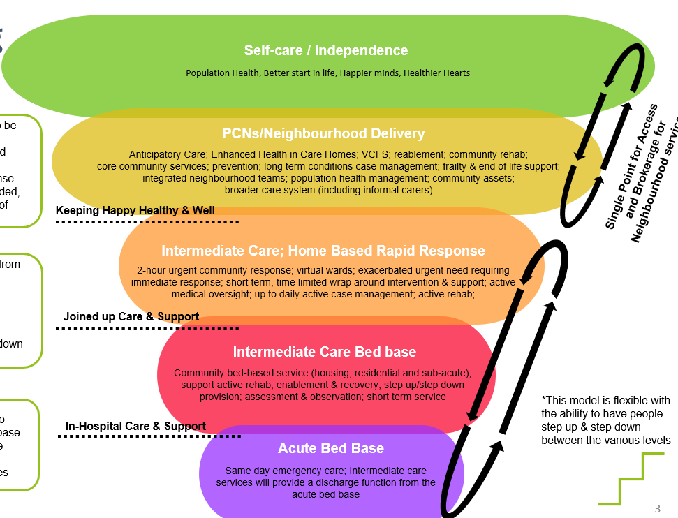
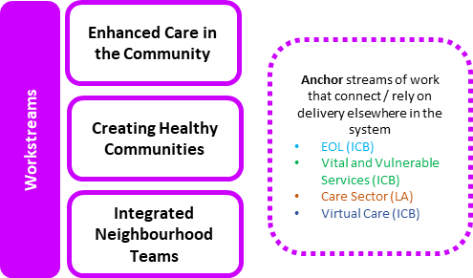
Operational Metrics
Focus of the group is to determine suggestions for outcome measures which will determine the success of the TCC programme – balancing assurance with the impact of transformation.
Initial work will be needed to shape a balanced approach to identifying appropriate measures and propose these to the TCC board for sign-off before establishing a way forward for mobilising any data/intelligence work required to mobilise these measures into an appropriate framework for reporting.
A key consideration is to minimise the risk of duplication and establish whether there is opportunity to cross-utilise indicators or outcomes measures within existing or developing ICB programmes.
After initial reflections, BI & Performance colleagues have suggested that the group consider a ‘3 pillar’ approach to shaping and grouping any outcome metrics, as detailed below.
Data Quality in
Key Datasets
2. Pull on outcome measures
that are utilised/emerging from within
Anchor streams of work + TCC Technology Enabled Steering Group initiatives
3. Consider and scope potential measures to monitor medium-longer term significant shifts of care focus
Key Indicators within emergent Community Reporting Strategy that are must-do’s for ensuring granular/linked intelligence across Out of Hospital care.
CSDS (Community Services Dataset)
MHSDS
MSDS
Etc.

