Slide 1


Locally Enhanced Service update
5 March 2025

Slide 2
Contents of Session
Welcome and etiquette [Peter]
Introduction and purpose [Peter]
National contract summary [Peter]
Local communication and unpacking [Donna]
Delivery planning [Donna]
Timeline [Donna]
Feedback [All]

Slide 3
Welcome and etiquette
Thank you for your patience
Wider financial context
Investment in General Practice
New sign off requirements
Relatedly responding to requests for additional financial information
Recognise your concerns
Share the same aim
Work together and not against one another
Welcome constructive and professional feedback (on the webinar via chat)

Slide 4
Introduction and purpose
Provide a summary of the national contract
Explain and unpack the local contract communication
Discuss delivery planning
Share the timeline
And approach to feedback today and over the coming weeks

Slide 5
National contract
£969 million new funding uplift, a 7.2 per cent total increase to core funds
real-terms increase is around 4.8 per cent after minimum wage and increases to employer National Insurance contributions
ARRS expanded to include GPs and practice nurses and reimbursement rates for GPs increased in line with BMA salaried GP range
Extending access is a major focus. Funding streams including QOF and CAIP streamlined with funding channelled into improvements to patient access through increased online booking from October 2025
GPC stepped down collective action and the government has agreed to the British Medical Association (BMA) proposal of a full renegotiation of a new national contract within this parliament
Advice and Guidance alignment to LES

Slide 6
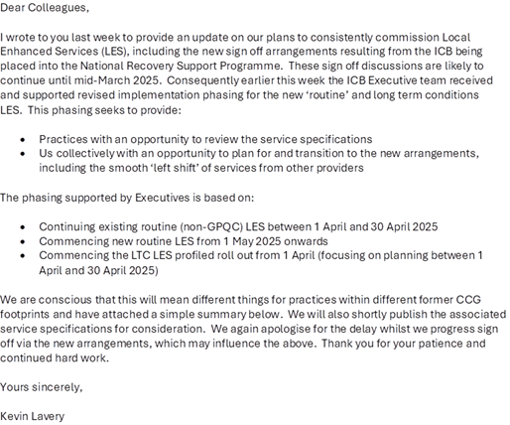
Local communication and unpacking

Slide 7
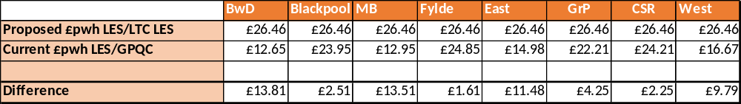
Costing
Each service has been costed using a bottom-up approach – identifying the task, time and staff required
We have engaged in extremely thorough negotiation with the LMC and walked through each service in detail
Table below shows the current £pwh and the proposed for each former CCG
The funding amounts available to practices in the table below do not include LES that are particular to a certain practice, or services delivered at scale i.e. atypical populations and vasectomy
The funding is now one pot, and practices may see differences in their historical values from each of the former GPQC and LES pots
Payments will be using weighted population figures for January 2025

Slide 8
Routine
LES costings
Capitated budget | £PWH
ECGs | £0.96
Phlebotomy | £3.08
Wound care | £0.93
Shared care For drugs that require 3 monthly tests an annual fee of £120 For drugs that require 6 monthly tests an annual fee of £60 For drugs that require 12 monthly testing an annual fee of £30 | £120 £60 £30
Meds optimisation | £5.50
Injections | £1.00
Advice and guidance * | £0.61
PSA testing | £0.44
End of life | £1.00

Slide 9
Routine
LES costings
Cost and volume | £
Care home (per bed) | £132.00
Minor surgery - excision - other practice patients only | £115.50
Minor surgery - injection - other practice patients only | £62.00
Ring pessary | £55.47
Complex injections | £20.00
Diabetes Initiation of insulin Initiation of GLP1 Ongoing care | £279.00 £55.00 £85.30
Spiro | £56.88
Feno | £28.00
Post bariatric monitoring | £45.00
Dementia | £34.20

Slide 10
Long Term Conditions LES
The proposed funding for the 2025/26 LTC LES is a phased increase from £6.79 for the first 6 months to £10 for the latter 6 months.
To support practices with planning and delivery we are proposing to pay the average of the 2 payments which equates to £8.40 for all 12 months.
Practices will receive 80% of their total contract value paid in equal 12ths across the year
An individual practice annual activity plan will be provided in the next few weeks
Activity will be profiled over 11months of the year to support practices undertake planning during April 2025.
Resource % |  | Activity Expectation
35% | Domain 1 | Implementation Administration & support to care coordinator/navigation support Case finding and risk stratification work Monitoring of outcomes and reporting Training needs assessment and meeting training requirements to deliver this LES Building relationships across practices and partners and ‘headspace’ for leadership and transformation activity
53% | Domain 2 | Segment 1 | Segment 2 | Segment 3 | Segment 4 | Segment 5
 |  | Clinical Case Finding | Population health Management | Long Term Condition 1 | Long term condition 2 | Severe Mental Illness
 |  | Case finding chosen according to variance from expected population prevalence | Use risk stratification and Inclusion Health knowledge to identify cohort. | Place based decision based on pop health and Place based knowledge | Place based decision based on pop health and Place based knowledge | Universal focus on individuals with SMI, undergoing stratification of health inclusion risk
12% | Domain 3 | MDT approach Practice level MDT, PCN level or collective MDT based on historic multi-practice working. Details and guidance about formation and delivery of MDT laid out in this specification. (page 35)

Slide 11
Intranet
Final specifications are available on the intranet for review. They remain subject to final ICB Board consideration and sign off in March. Alongside the specifications you’ll also find:
FAQs for each specification, developed using your feedback from webinars and elsewhere
Supporting documents with further materials to be added as they become available
A general FAQs section covering wider queries
Webinar recordings and communications, where all previous sessions and updates will be stored
To help us understand what services you intend to provide we’d be grateful if you could complete an online form by 14th March 2025. Please note that this is only an indication to help us plan and not a formal sign up as we appreciate, you’ll want more time to fully consider the specifications.

Slide 12
Delivery planning

Slide 13
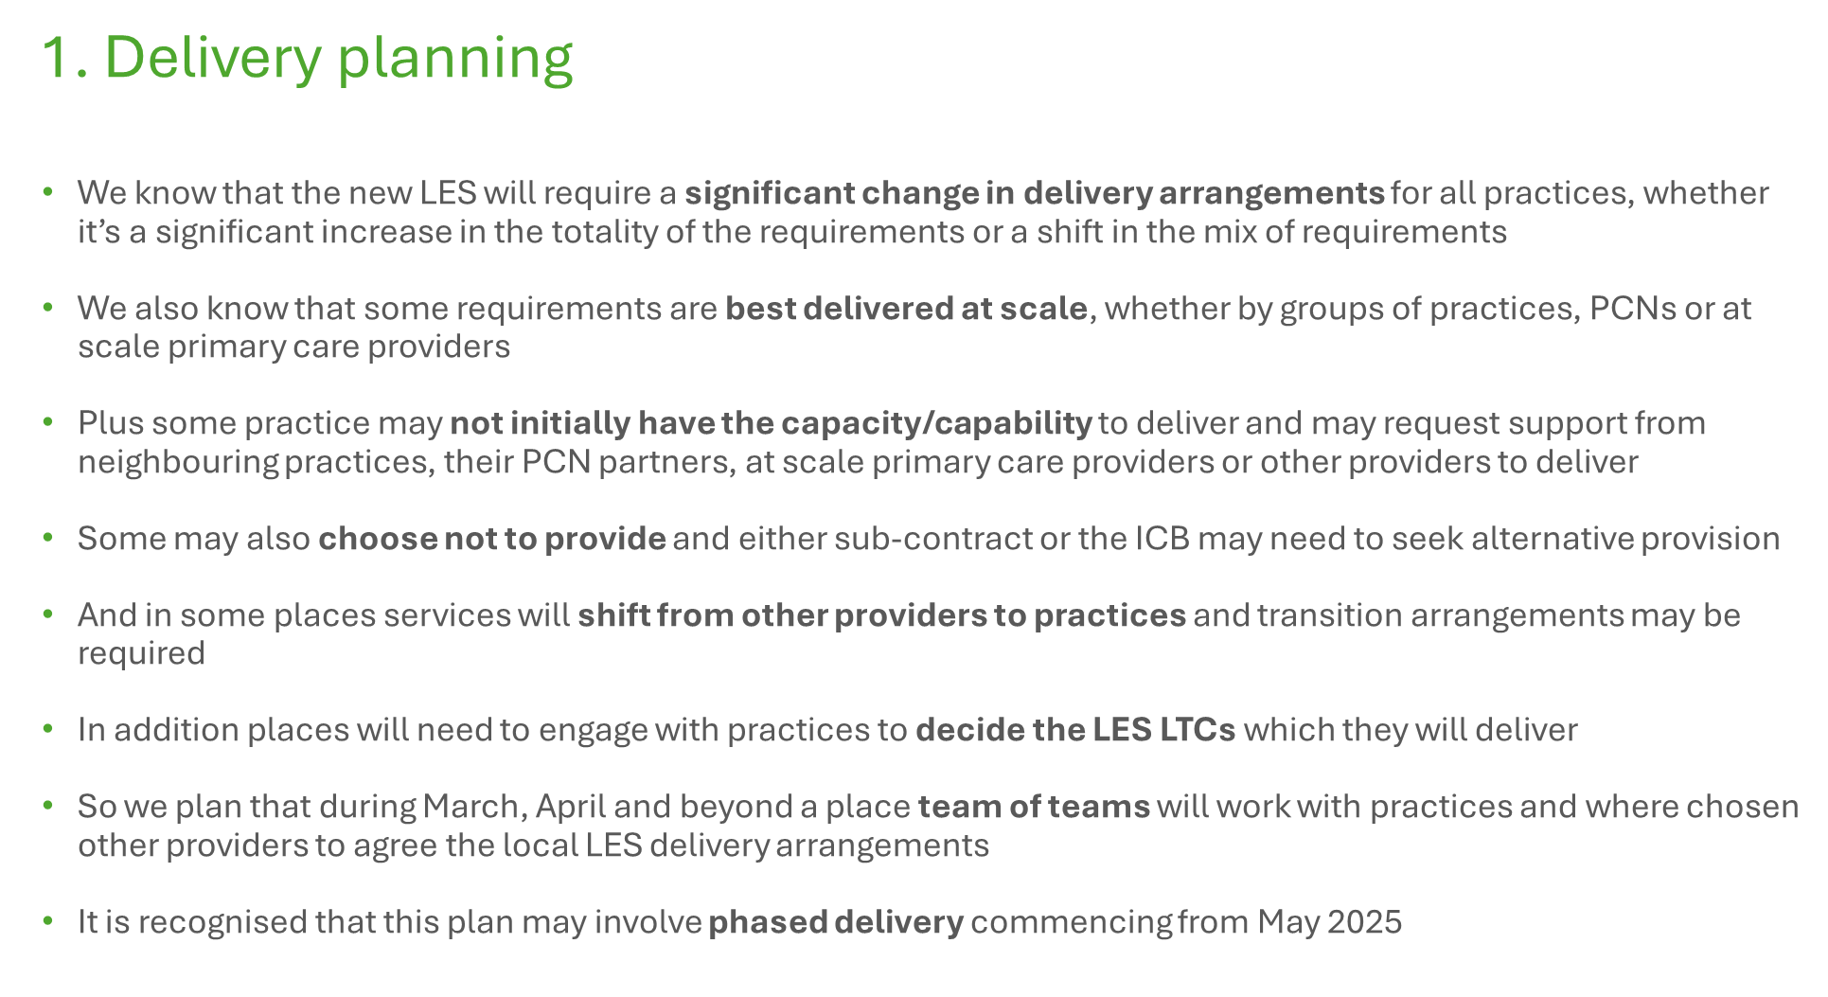

Slide 14
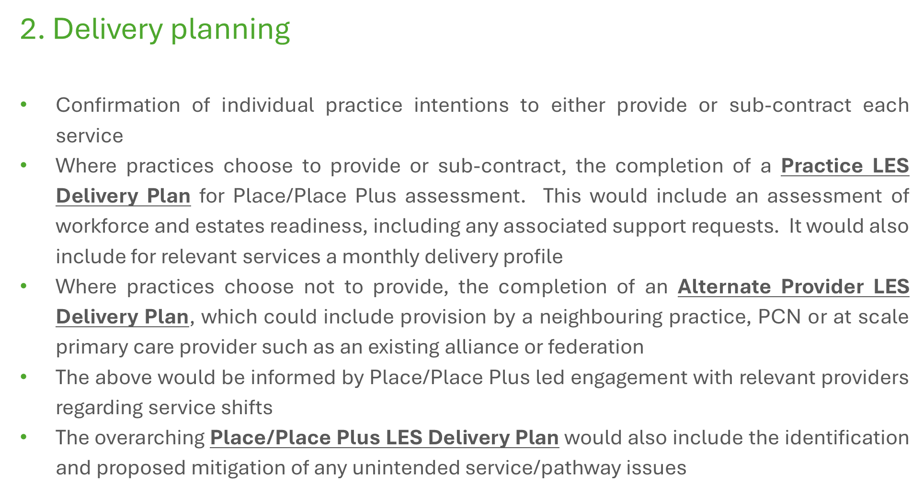

Slide 15
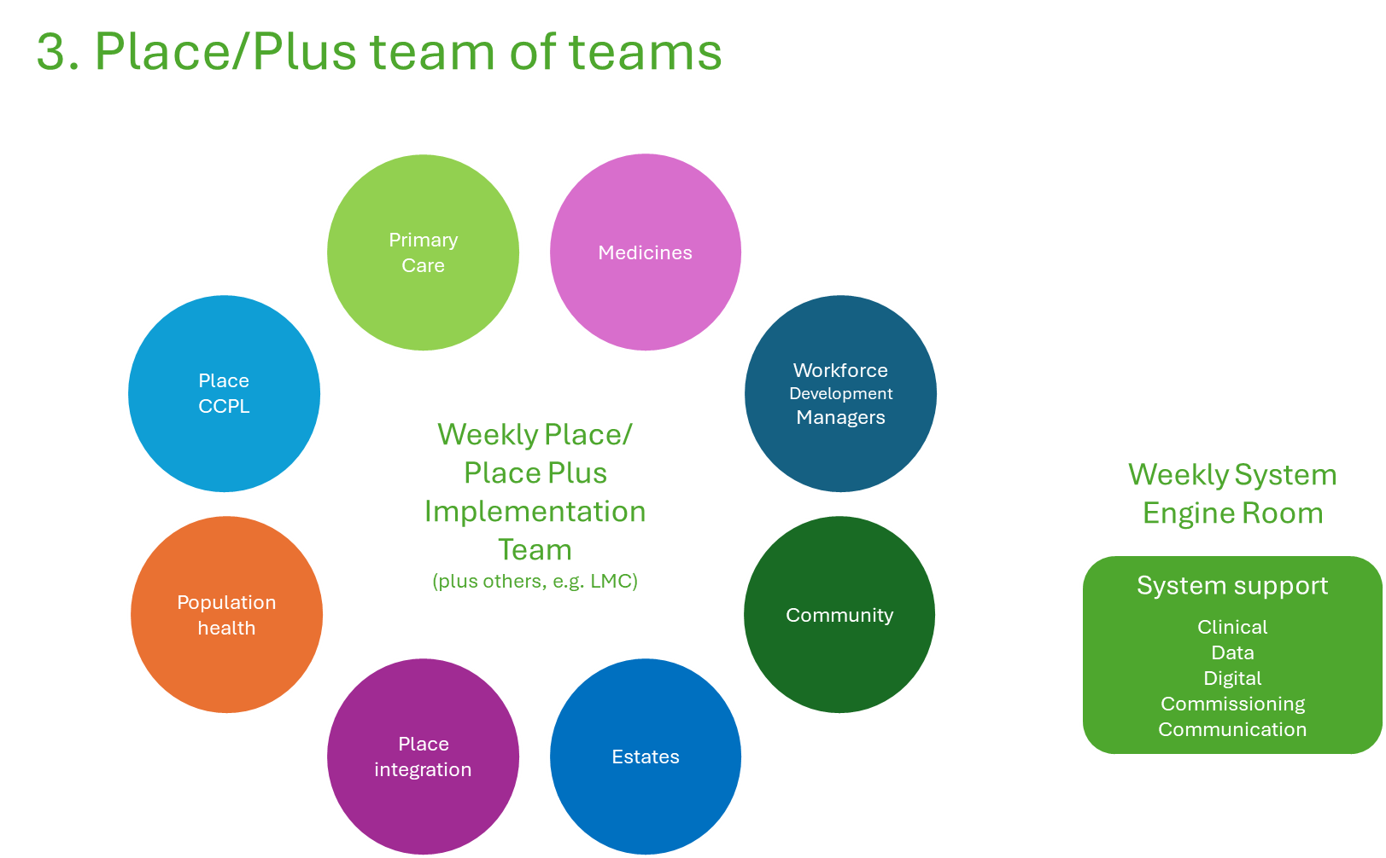

Slide 16
LTC choice
"places will need to engage with practices to decide which LTCs they will deliver"
Some expectations:
The conversation should start at Place Plus (Morecambe Bay, Fylde Coast, Central and West Lancashire and Pennine Lancashire)
ICB Primary Care leads (Associate Medical Directors) working with Place leads (Directors of Health and Care Integration and Clinical and Care Professional Leads) will co-ordinate the conversation using any existing forums wherever possible
The conversation should (as a minimum) include (or have sought feedback from in advance for consideration) all practices and PCNs plus local authority, hospital and community provider partners. You may wish to invite other partners.
The conversation should consider the population health data provided plus local intelligence and determine:
  Whether it makes sense to select one or both LTCs on a Place Plus, Place or other PCN grouping
  It is not envisaged that the population health data will support individual PCN selection
  How partners will work together to plan and deliver the LTCs, including sharing learning
  Whether there are any support asks such as training

Slide 17
Timeline

Slide 18
Timeline
This phasing seeks to provide:
  Practices with an opportunity to review the service specifications.
  Provides an opportunity to plan for and transition to the new arrangements, including the smooth ‘left shift’ of services from other providers.
Date | Plans
25 Feb 2025 | ICB Executive team supported revised implementation phasing for the new ‘routine’ and long-term conditions LES
Mid-March 2025 | New sign off arrangements resulting from the ICB being placed into the National Recovery Support Programme likely to continue until mid –March 2025 LES indication form returned by 14th March LTC LES condition choices confirmed by 21st March
1 April to 30 April 2025 | LTC LES planning month - Commencing the LTC LES profiled roll out from 1 April (focusing on planning between 1 April and 30 April 2025)
1 April to 30 April 2025 | Current routine LES to be extended for 1 month - Continuing existing routine (non-GPQC) LES between 1 April and 30 April 2025
1May 2025 | Commencing new routine LES from 1 May 2025 onwards

Slide 19
Any questions or feedback?

