Slide 1


Locally Enhanced Service update
Thursday 27th March 2025

Slide 2
Welcome, content & purpose
Update and sign off by ICB
Thank you to you for completing and submitting EOY monitoring forms.
Summary of key changes to LTC LES/Routine LES’s inc. activity and costs
End of Year process, deadlines and mitigation
Delivery Planning - Team of Team developments & LTC LES priority areas
Guidance documents, communication and GP intranet
Welcome constructive and professional feedback (on the webinar via chat)

Slide 3
Summary of key changes
Service LES (now referred to as ‘routine’ LES)
The current 2024/25 service LES will continue during the month of April 2025 and practices will continue to claim and be paid on the same basis for this month.
Where a practice has already ceased providing any service LES or has previously provided formal (written) notice to cease providing from April they will not receive the corresponding payment (unless they immediately formally confirm they now intend to provide).
The new routine LES will commence from 1 May 2025 onwards and practices will receive the corresponding payment for services that they have confirmed they will provide.
GPQC and LTC LES
The current 2024/25 GPQC ceases on the 31 March 2025 and practices will receive their final payment based on achievement no later than June 2025.
The new LTC LES commences on 1 April 2025 and practices will receive the corresponding payment if they have confirmed they will provide the service.
Practices may choose to undertake LES preparatory planning during April with activity starting from May.
LES payments for 2025/26
ICB to circulate to practices a simple comparison of the income they can earn this year (2024/25) and next year (2025/26) for each month of the year and in total
Practices can also calculate their own forecast by inputting activity levels from EMIS into the ready reckoner on the intranet.

Slide 4
Quality Contract - end of year monitoring requirements & mitigation
Thank you for those who have submitted forms to date:
SMR - No change to SMR template (MS Forms) deadline 31st March
Frailty – 10 questions removed from original template (remains on Word) submission deadline 2nd May 2025
Respiratory – 9 questions removed from original template (online MS Forms) submission deadline 14th April
LES online form to indicate which LES’s practices intend to deliver in 2025/26.

Slide 5
End of year monitoring summary
Frailty Deadline: Monday 2nd May 2025 Bundles 2, 3 and 4 | Bundle 1 (activity date) - Practices are not required to complete the data for Q4. Bundle 2 (practice & patient education)– Practices to complete all questions and a minimum of 1 case study to cover the 6 key areas outlined in spec by 2nd May. Bundle 3 (MDT) – Practices to complete Questions from KPI 1 & 3. Bundle 4 (staff training) – practices to complete 2 x tables.
Respiratory Monday 14th April 2025 Bundle 2 – only KPI 3 | Bundle 1 (training) – Practices are not required to complete questions 1, 2 or 3. These have been answered via the information provided during the year. Bundle 2 KPI 3 questions on reflection and learning ONLY to be completed on MS Forms link. Bundle 3 – practice EMS report – No submission required.
SMR 31st March 2025 | SMR EOY template to be completed by practices (MS Forms link)

Slide 6






GPQC 24/25 - Mitigation Timeline
Practices to complete their mitigation via Microsoft forms link.
Mitigation panel to meet and review submissions.
Panel to inform Place teams on practice outcomes.
Practices to receive outcome of Mitigation panel.
ICB to confirm with finance for practice payments/clawback.
Practice payments/clawback to be processed.
2nd May
6th May
20th May
30th May
9th June
Mid-June
Important to note: Mitigation will only be accepted in exceptional circumstances

Slide 7
Delivery planning

Slide 8
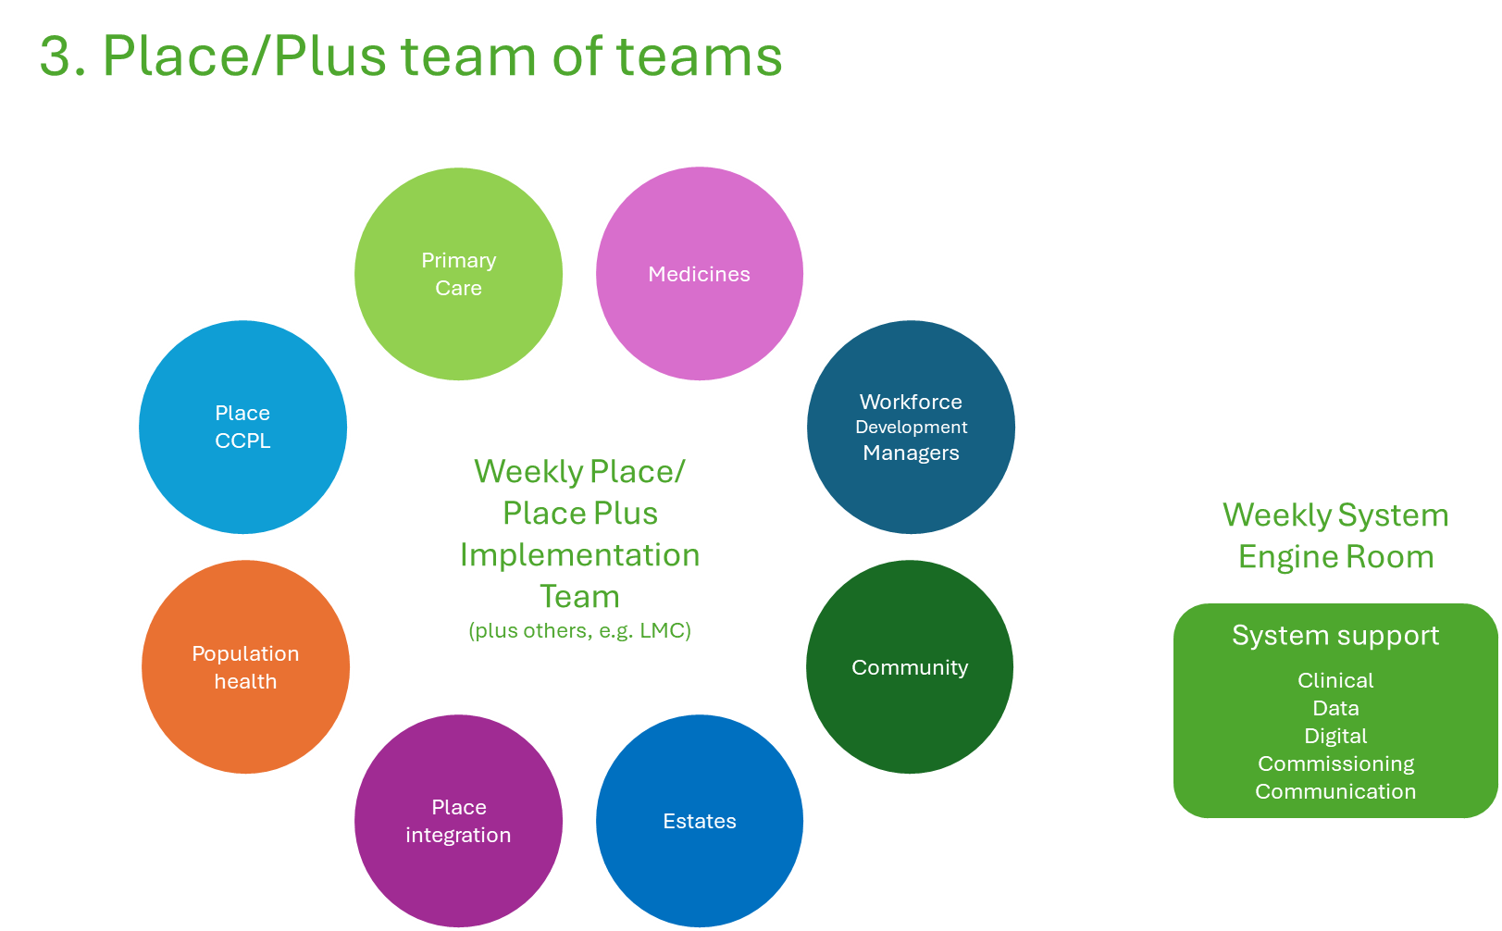

Slide 9
LTC LES choices
"places will need to engage with practices to decide which LTCs they will deliver"
Team of Team meetings have been underway, population health data packs and practice poll utilised to discuss and agree the LTC LES priority areas per area, below is an update:
Area | Priority areas confirmed for 2025/26
Blackburn with Darwen | Frailty and Respiratory
East Lancashire | Diabetes and Respiratory
Blackpool | Respiratory and CVD
Lancaster District | Respiratory and CVD
South Cumbria | Respiratory and CVD
Fylde & Wyre | CVD and Diabetes
Central Lancashire | Respiratory and CVD
West Lancashire | Respiratory and CVD

Slide 10
Data searches and guidance - timescales
Long Term Condition LES guidance inc. searches and case finding available today and will be uploaded in the technical guidance document on the Intranet for all practices.
Capitated LES guidance to be available from week commencing Monday 7th April. Exc. Shared care and meds ops.
Cost and Volume LES guidance to be available from week commencing Monday 21st April.
Please contact your local Quality Team member with any queries.

Slide 11
Intranet
Final specifications are available on the intranet for review, alongside the specifications you’ll also find:
FAQs for each specification, developed using your feedback from webinars and elsewhere
Supporting documents with further materials to be added as they become available
A general FAQs section covering wider queries
Webinar recordings and communications, where all previous sessions and updates will be stored
Technical Guidance – ongoing updates for LTC LES/LES searches and codes
Training opportunities
Month 11 data set

Slide 12
Any questions or feedback?

