Slide 1

Primary Care – Aseptic Non Touch Technique
ANTT Refresher
September 2025

Slide 2

Healthcare Legislation
Governments in an increasing number of countries are using legislation to ensure health care organisations adopt a ‘single standard approach to aseptic technique’ that is evidenced by education and audit.

Slide 3
Why is Aseptic Technique so important?
Microorganisms are EVERYWHERE- all the time
Microorganisms are invisible and occupy all spaces in the clinical environment.
Harmful bacteria and viruses are easily carried around clinical environments.
Healthcare environments often include atypical and resistant microorganisms.
The aseptic technique is critical in preventing microorganism transference onto or into patients.

Slide 4
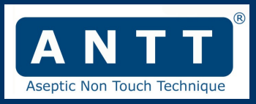
Effective ANTT Implementation
Aseptic technique is a critical clinical competency that is paramount to patient safety.
This brief presentation outlines how to effectively implement a standardised form of aseptic technique termed ANTT®.
ANTT is defined as being a, ‘Specific type of aseptic technique with a unique theory and practice framework’ (National Institute for Health & Care Excellence 2012).

Slide 5

What does Asepsis mean to you?
‘Aseptic technique’ is a generic term applied to a set of specific practices- including hand decontamination, use of personal protective equipment, and prevention of contamination of susceptible sites and sterile parts of devices.
Sterile?
Clean?
Aseptic?

Slide 6


Definitions…
Clean
Visibly clean- no marks or stains are seen by the eye.
Sterile
The complete absence of microorganisms.
Aseptic
The absence of harmful microorganisms in sufficient quantity to cause infection.

Slide 7
Asepsis…
Asepsis is defined by Rowley and Clare as:
‘Free from pathogenic microorganisms, in sufficient dose to cause infection’
Regardless of procedure, equipment or setting. Healthcare workers must have an ‘aseptic intention’ when caring for patients

Slide 8
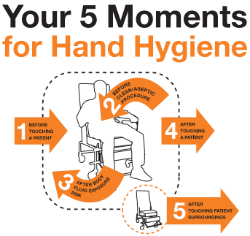
Asepsis starts with good hand hygiene
Hand hygiene starts with good skin care | Royal College of Nursing

Slide 9



What is Non-Touch Technique?
If you always apply the principles of ANTT® for every clinical procedure, you can minimize the three risks of contamination present in aseptic technique
The three contamination risks are:
Airbourne
Hand Touch
Object / Surface Touch

Slide 10
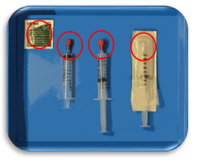
Key-Part and Key-Site Protection
ANTT® achieves asepsis by a unique methodology called ‘Key-Part and Key-Site Protection’ … In other words, the protection of Key-Parts and Key-Sites from harmful microorganisms
• Key-Parts are the critical parts of procedure equipment that if contaminated will transfer micro-organisms to the patient
• Key-Sites are any break in the patient's natural skin integrity that provides a portal of entry for micro-organisms

Slide 11

Protection is achieved by the mindful application of:
• Standard Precautions (SICP’s)
• Appropriate and effectively used personal protective equipment (PPE)
• The correct use of aseptic fields
• Non-touch technique
‘Key-Parts must only come into direct contact with other aseptic Key-Parts and Key-Sites’

Slide 12
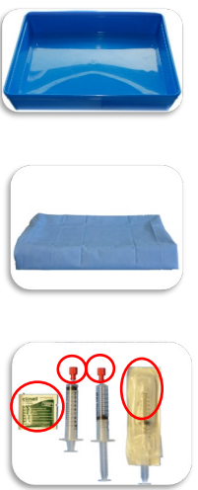
Different Aseptic Fields
‘General Aseptic’ Field (Promoting asepsis)
– A procedure tray, trolley etc.
‘Critical’ Aseptic Field (Ensuring asepsis)
- A sterilised drape or sterile procedure pack.
‘Micro Critical’ Aseptic Field (Ensuring asepsis by protecting key-Parts individually).
- Sterile caps, covers or recently opened sterile packaging.

Slide 13
Surgical Vs Standard Asepsis
THINK WHICH PROCEDURE AND WHEN?
What procedures are undertaken at your surgery?
Standard Asepsis: Used for clinical procedures where achieving asepsis is straightforward and short in duration.
Surgical Asepsis: Used for more complex procedures such as minor surgery where the main aseptic field needs to be managed in a more critical manner with sterile drapes, a critical aseptic field and sterile gloves.

Slide 14

Gloves
Glove awareness | Campaigns | Royal College of Nursing
What type of gloves are required?
When should I wear gloves?

Slide 15
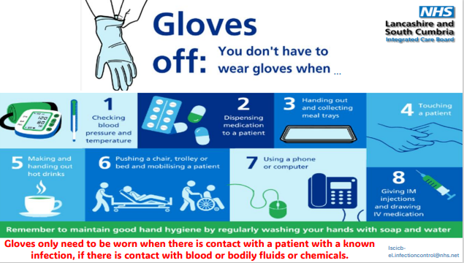
Gloves should ONLY be worn when there is a patient with a known infection, if there is blood or bodily fluids or chemicals

Slide 16
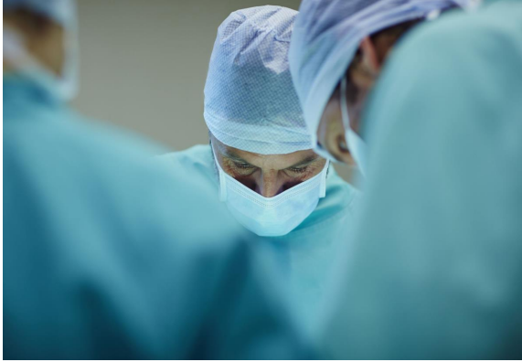
Environment
What procedure is being undertaken?
Is the room free from clutter and easy to decontaminate?
What procedures constitute as minor surgery?
Is there adequate ventilation?
Functional risk (FR) category? (2 or 4)?

Slide 17
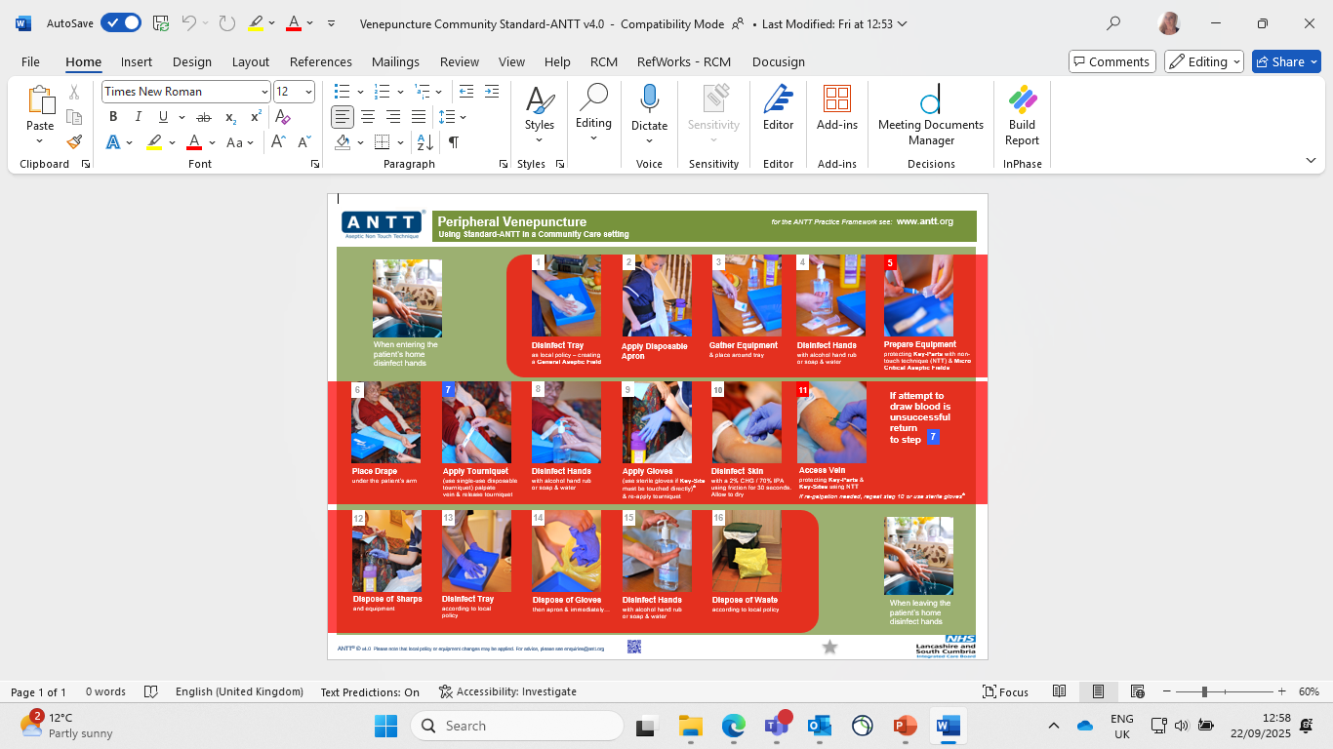
Peripheral Venepuncture Guidelines (Standard ANTT- community settings)

Slide 18
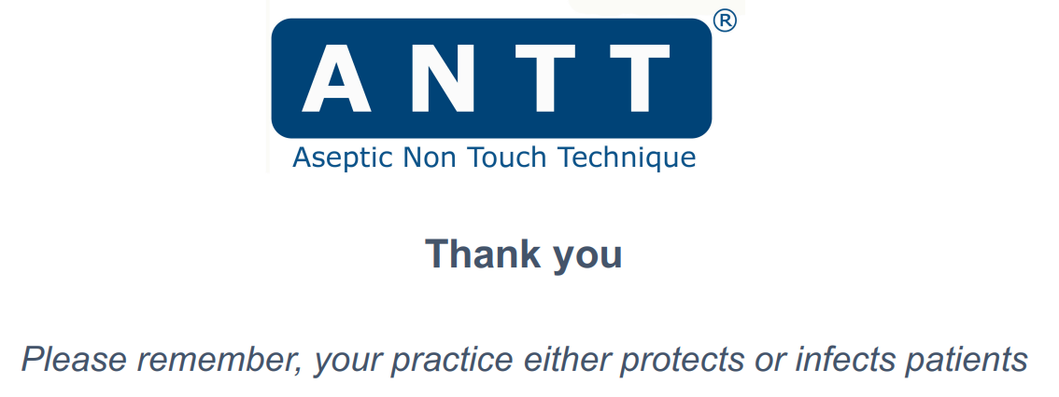

Slide 19
Useful Resources
• https://www.rcn.org.uk/news-and-events/Blogs/hand-hygiene-starts-with-good-skin-care-040524
• Glove awareness | Campaigns | Royal College of Nursing
• Five moments for hand hygiene
• NHS England » National standards of healthcare cleanliness 2025
National Standards of Healthcare Cleanliness 2025 for General Practice - Infection Prevention Control
• NHS England » National infection prevention and control manual (NIPCM) for England
• Home –ANTT.org
• Resources - Infection Prevention Control
References-
Loveday et al. (2014) epic3: National evidence-based guidelines for preventing healthcare-associated infection in NHS hospitals in England Journal of Hospital Infection Jan (86) Supplement, S1-S7
National Institute for Health and Clinical Effectiveness (2012) Healthcare-associated Infections: prevention and control in primary and community care. Clinical Guideline 139 https://www.nice.org.uk/Guidance/CG139
Rowley and Clare (2020) How widely has ANTT been adopted in NHS hospitals and community care organisations in England and Scotland? British Journal of Nursing. 29:924-32

Slide 20

Team of 3 full-time IPC nurses:
Vanessa Morris - vanessa.morris2@nhs.net
Hannah Goldsmith - Hannah.goldsmith5@nhs.net
Adele Quinn- adele.quinn2@nhs.net
Generic inbox – Iscicb-el.infectioncontrol@nhs.net
Hours of Work: Monday – Friday 8-5pm. On-call/out of hours service available with ICB on-call.
Web lancashireandsouthcumbria.icb.nhs.uk | Facebook @LSCICB | Twitter @LSCICB

