Slide 1

Local Enhanced Services (LES) update
18th March 2026

Slide 2
Welcome and Webinar Etiquette
• Thank you for joining today and for the continued delivery of Local Enhanced Services across Lancashire and South Cumbria.
• Today’s session will provide an update on the 2026/27 LES programme, including service changes and funding arrangements.
• We will also reflect on learning from the first year of the capitated LES model in 2025/26.
• We recognise practices have raised several queries regarding the 2025/26 Capitated LES End of Year position and we will address these today.
• Please ensure that all contributions remain professional and respectful.
• Please use the chat function during the webinar to raise questions.

Slide 3
LES 2025/26 – Capitated LES End of Year Projections

Slide 4
Capitated LES 2025/26
Consistent LES commissioning and significant extra investment
Recognise this has been a transitional year and year 1 of 3
Considerable interest in delivery, including potential for future left shift and investment in primary care
Some of LES investment predicated on activity left shift and funding left shift
Some of activity plans were based on forecasts, typically where we had robust data from one place we could apply to other places
Most practices have delivered more than 50% of the indicative plans and some over 100% - thank you for all your hard work
Some practices appear to have delivered not as much
From feedback we are aware that for some practices this relates to data capture and reporting issues – see next slide
Also please let us know about any other delivery issues you've encountered
We'll then meet with LMC colleagues to review and agree next steps
Its really important we get this right for next year to ensure we are accurately capturing and reporting what practices have delivered and we can demonstrate to others
As you'll hear shortly, we also think it will be easier and fairer but put a simpler approach in place for next year

Slide 5
Mitigation examples
Following queries from practices we have reviewed the common themes with the LMC and agreed the following will be accepted under mitigation:
  Sub-contracting activity
  EMIS Enterprise activity
  Practices will be provided with mitigation guidance and a template to support the submission of mitigation. Timeline provided on next slide.
  Any additional queries raised by practices will be addressed in a follow‑up letter to be circulated shortly.

Slide 6








LTC LES & Capitated LESs- End of year & Mitigation Timeline
Practices to receive outcome of Mitigation panel.
ICB to confirm with finance for practice payments/recovery of funds.
Practice payments/recovery of funds to be processed.
Mitigation panel to meet and review submissions.
Practices to submit their mitigation via the relevant Microsoft forms link provided by the ICB.
Following completion of the year-end data extract in April 2026, practices will be issued with a final end-of-year performance letter.
To support timely reconciliation, all eligible activity must be fully coded, late submission will delay confirmation of the final position and impact the timing of associated payments.
10th April
30th April
8th May
13th May
29th May
8th June
Mid June

Slide 7
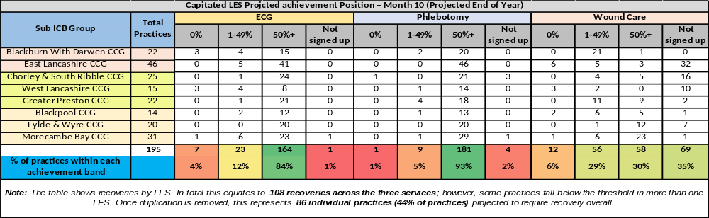
Capitated LES Projected Achievement LSC

Slide 8
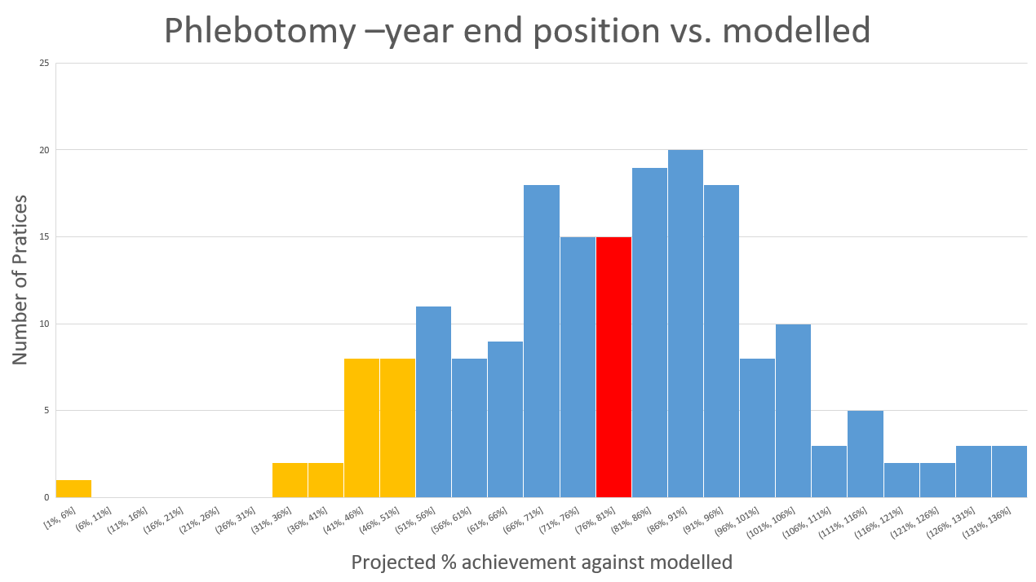

Slide 9
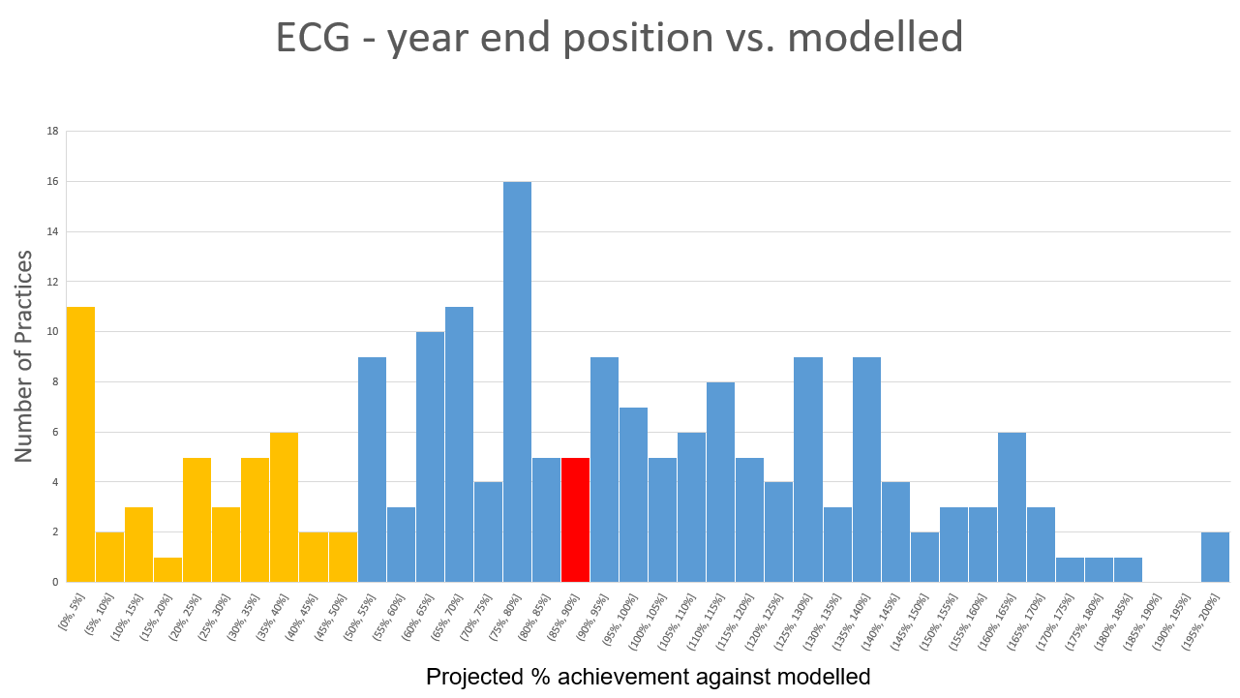

Slide 10
Changes to LES Contracting Arrangements – 2026/27
To ensure fairness for all we are moving to a mainly Cost & Volume approach
The following LESs will move from Capitated to Cost & Volume in 2026/27:
• Simple Injections
• PSA
• Simple Wound Care
• ECGs
Unit Cost Increases
• Simple Injections: £6.00 → £8.55
• Simple Wound Care: £15.06 → £21.95
The following LES will remain as Capitated:
Phlebotomy
End of life
Care home

Slide 11
LES Contracting Arrangements – 2026/27
Apologies that the sign-up process has not yet been completed.
Specifications and sign-up forms are due out from the CSU contracting team later today with a return date of next Friday.
A forms survey will also be circulated today for completion by close of play Friday to enable us to identify any service continuity issues for patients and enable us to commence transition conversations.

Slide 12


Primary Care Training Hub – update on training opportunities
We are delighted to announce that, following additional funding for 2026-27 from the ICB for primary care staff training, several opportunities will continue to be available:
• Respiratory training – updates and new spirometry virtual dates to be announced, along with ongoing access to individual modular e-learning.
Lunch Respiratory masterclass with Tracy Kirk – taking place on 6 May (further details to follow).
• Wound care training for dates and information see our event calendar on website Lancashire and South Cumbria Training Hub – Supporting Quality Education and Development in Primary Care
• Ring pessary training for dates and information see our event calendar on website Lancashire and South Cumbria Training Hub – Supporting Quality Education and Development in Primary Care
If you have any queries, please send them to the main inbox: mbpcc.lscthub@nhs.net

Slide 13

Web lancashireandsouthcumbria.icb.nhs.uk | Facebook @LSCICB | Twitter @LSCICB

